Slide 1
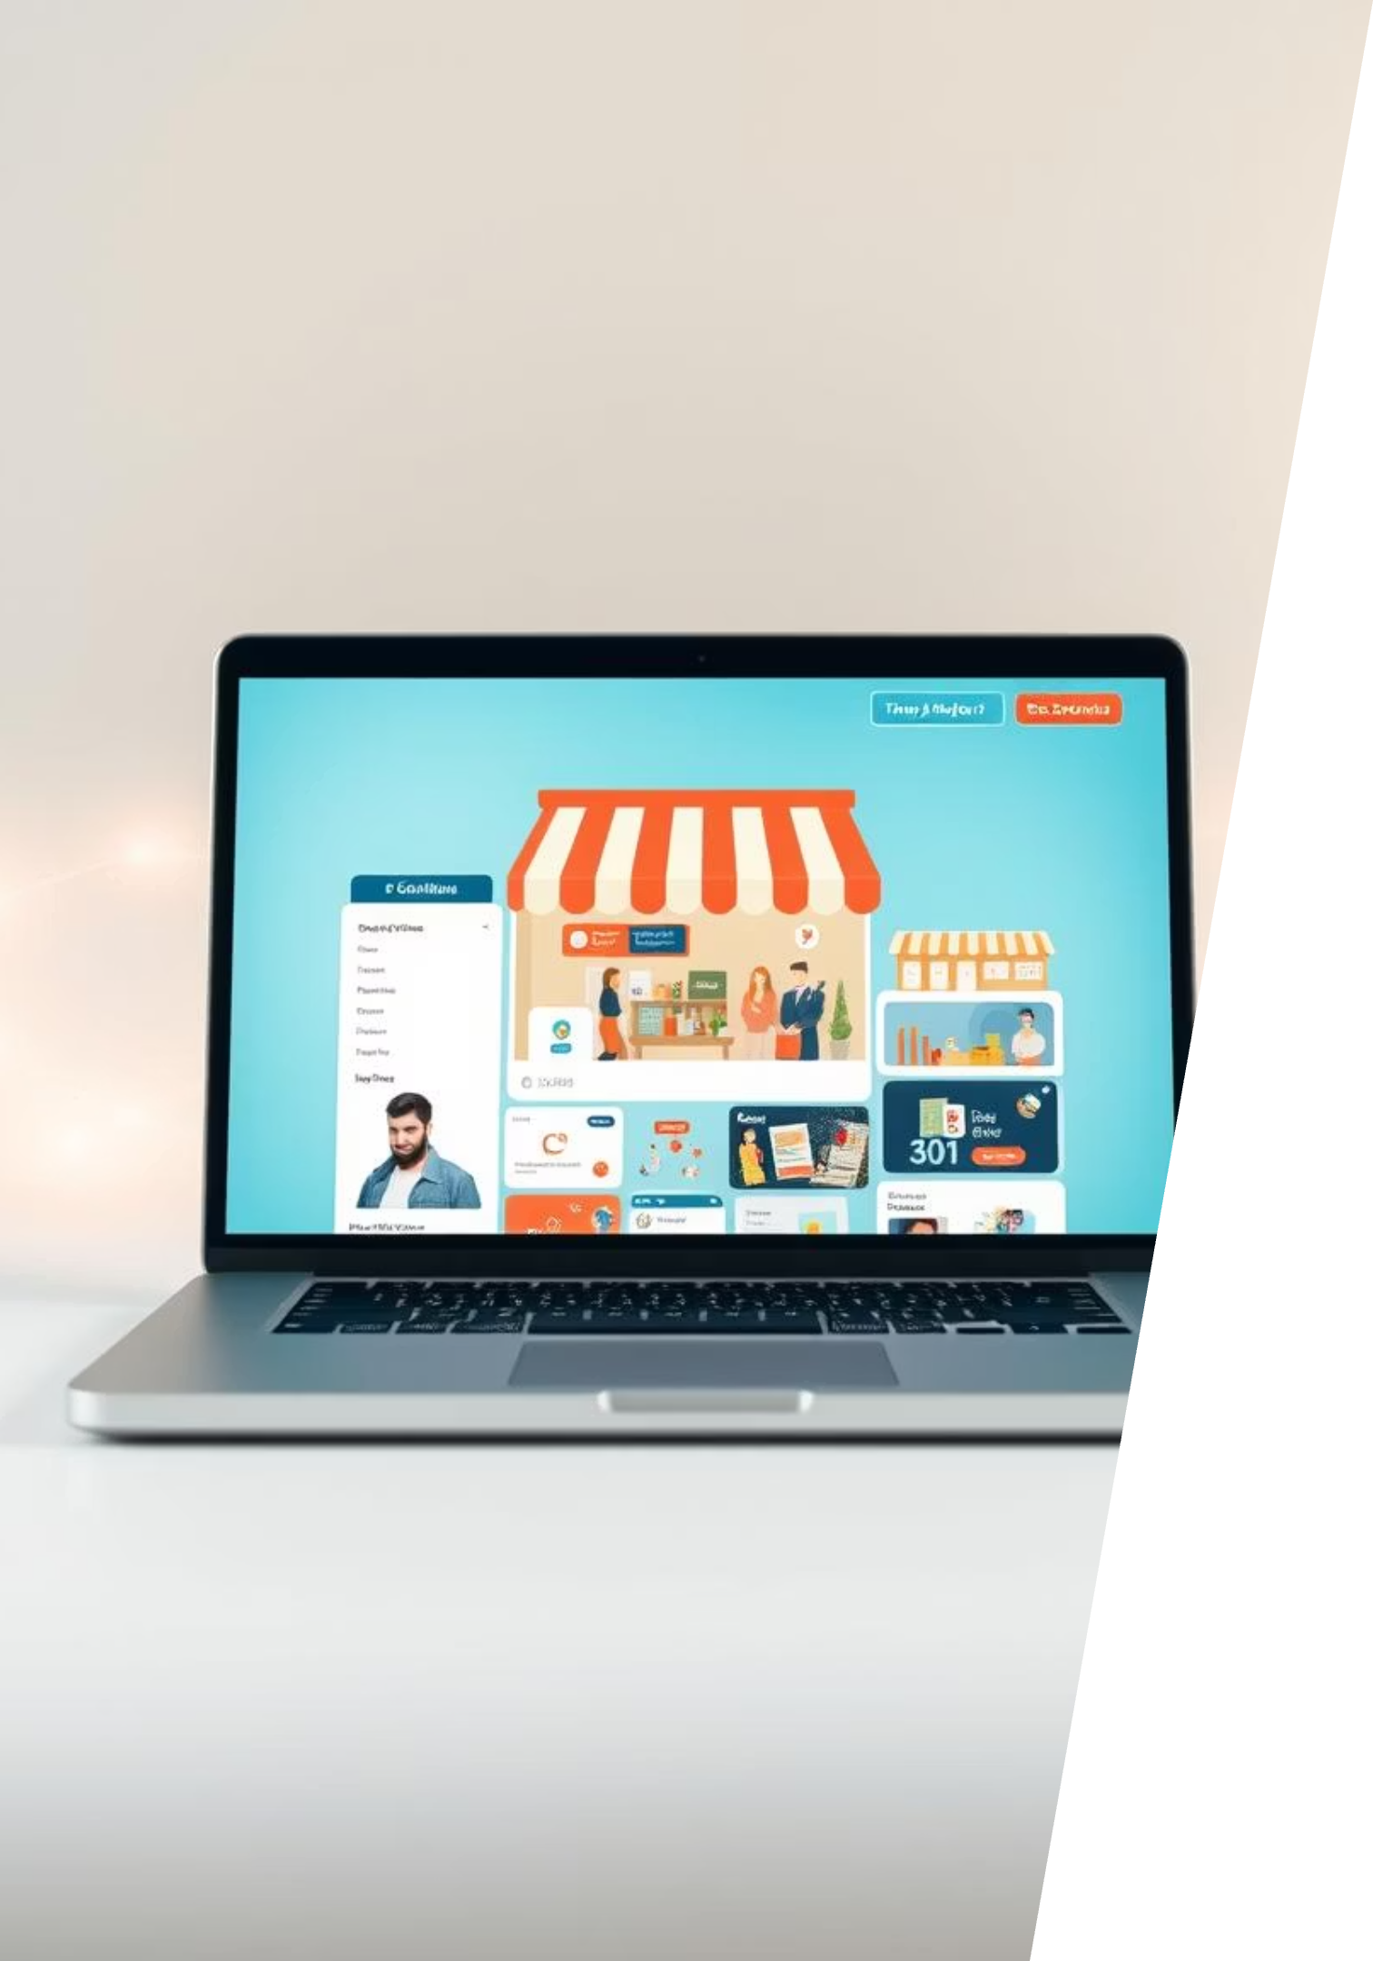

Building a Seamless Shopping Experience with React.js
Welcome to our presentation on the development of a cutting-edge frontend-only eCommerce application. This project showcases the power of React.js in creating intuitive and highly responsive user interfaces for modern web applications.
by ANKUR DAS

Slide 2
Presentation Roadmap
1
Introduction to the Project
A brief overview of our eCommerce frontend application built with React.js.
2
Core Objectives
Defining the primary goals for this user-centric and responsive application.
3
Technology Stack
Exploring the key technologies and libraries empowering our application.
4
Key Features
Highlighting the functionalities that enhance the user shopping journey.
5
Visual Overview
A glimpse into the application's interface through screenshots.
6
Development Challenges
Addressing the hurdles overcome during the development process.
7
Future Enhancements
Outlining the exciting potential for future growth and expansion.

Slide 3

Introduction: Crafting the Future of eCommerce
This project is a frontend-only eCommerce application meticulously crafted using React.js. Our primary purpose was to demonstrate the capabilities of modern web development in creating rich, interactive, and highly performant user interfaces.
The core idea was to build a robust, scalable, and delightful shopping experience that serves as a foundation for future full-stack integrations. It emphasizes intuitive navigation, smooth user flows, and an engaging visual aesthetic, all powered by React's component-based architecture.

Slide 4

Our Core Objective: User-Centric & Responsive Design
The main objective of this project was to build a highly user-friendly and responsive eCommerce frontend application. Leveraging the power of React.js, we focused on creating an intuitive shopping experience that adapts seamlessly across all devices, from desktops to mobile phones.
Key to this objective was ensuring optimal performance, fast loading times, and a smooth, engaging user journey. We aimed for a clean, modern aesthetic combined with robust functionality, setting a new standard for frontend eCommerce applications.

Slide 5
Under the Hood: Our Technology Stack
React.js
React Router
The foundation of our application, providing a declarative and component-based approach to building dynamic user interfaces. Its efficiency and vibrant ecosystem were crucial for rapid development.
Essential for handling navigation within the single-page application. It ensures a seamless user experience by enabling client-side routing, making the app feel fast and fluid.
CSS3 / SASS
JavaScript (ES6+)
Utilized for styling, ensuring a visually appealing and consistent design across the application. We implemented modern CSS techniques for responsiveness and elegant aesthetics.
The primary programming language, leveraging its latest features for cleaner, more efficient, and robust code. This allowed for advanced functionalities and improved developer experience.

Slide 6

Key Features: A Seamless Shopping Journey
Dynamic Product Listing
Interactive Shopping Cart
An intuitive display of products with filtering and sorting options for easy browsing.
Users can add, remove, and update product quantities with real-time total calculations.
Responsive Design
Client-Side Routing
Optimized layout for a consistent and enjoyable experience across desktops, tablets, and mobile devices.
Seamless navigation between different sections of the app without full page reloads, using React Router.

Slide 7
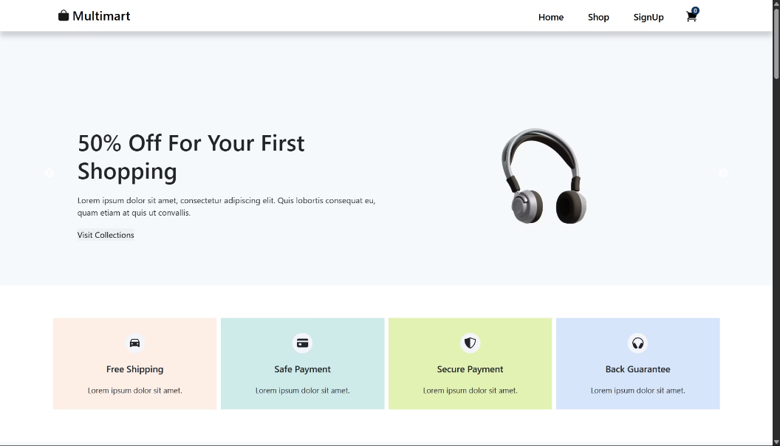
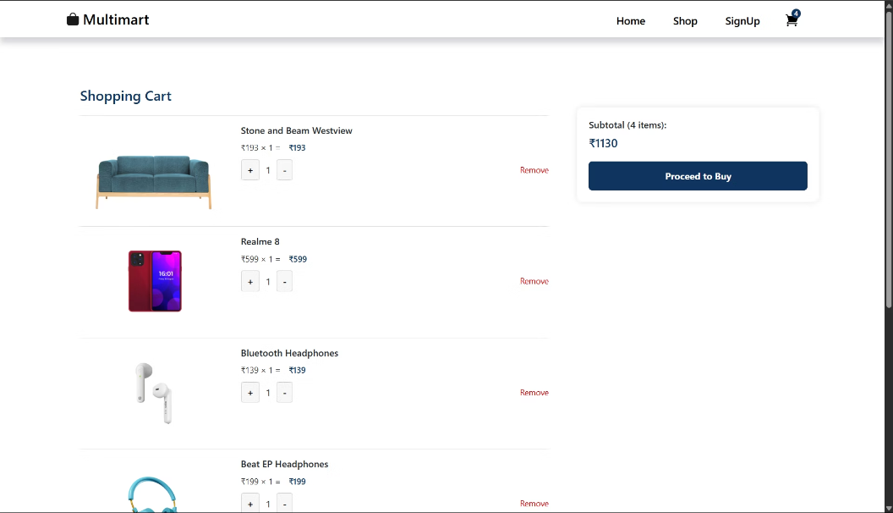
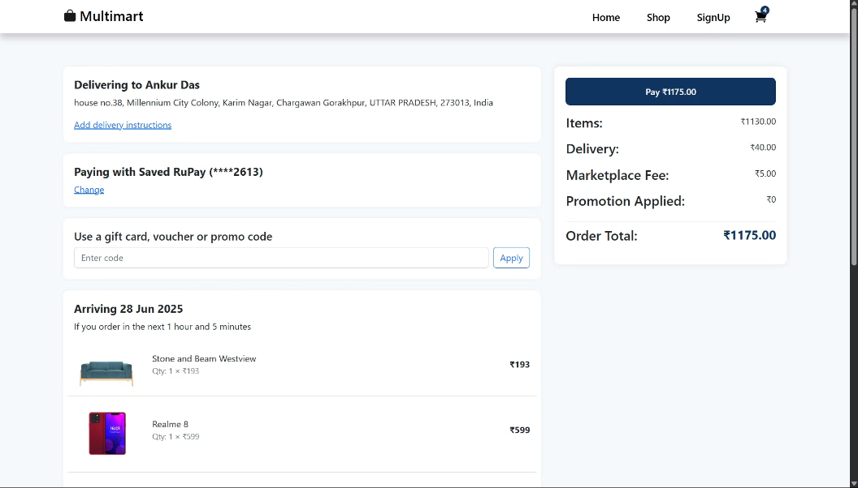
Application Walkthrough: Visualizing the Experience
Home Page
Cart Page
Payment Page

Slide 8
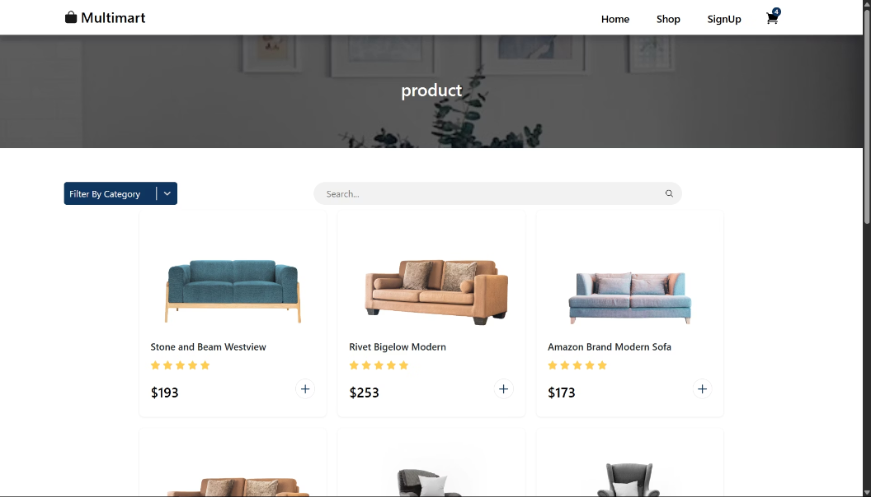
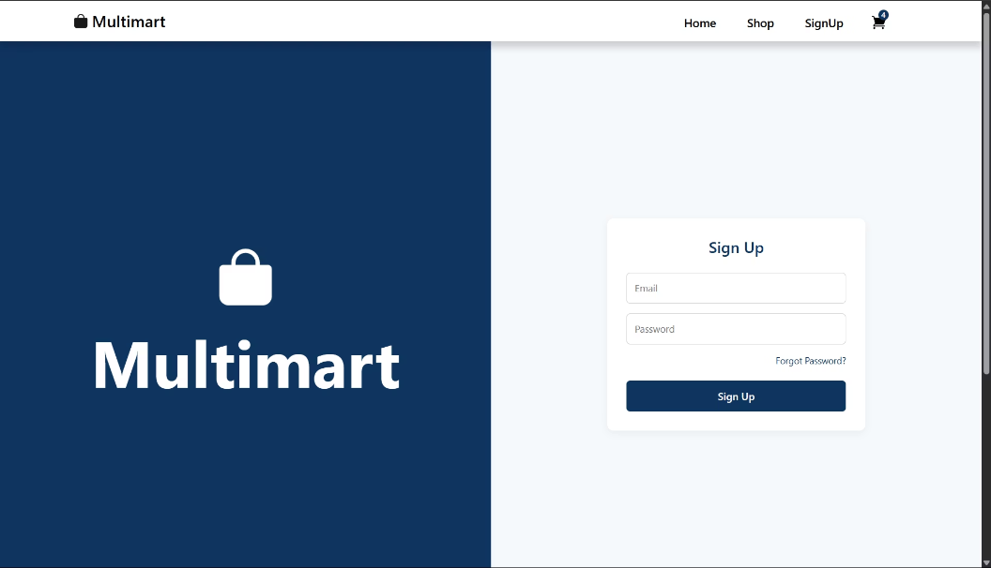
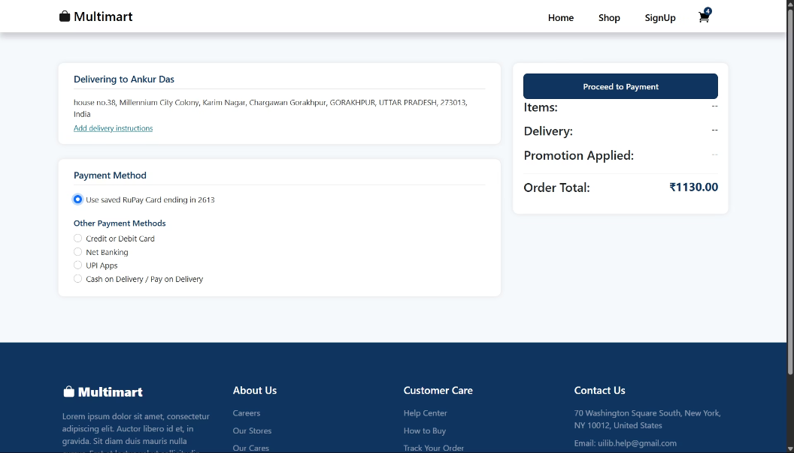
Product Page
SignUp Page
Checkout Page

Slide 9




Navigating Development Challenges
Developing a sophisticated frontend application always presents unique challenges that push the boundaries of technical expertise and design creativity. Our journey was no exception.
State Management Complexity
Handling global application state effectively across multiple components while maintaining performance.
Ensuring Pixel-Perfect Responsiveness
Achieving consistent UI/UX across diverse screen sizes and devices required meticulous CSS and layout adjustments.
Optimizing Performance
Implementing strategies like lazy loading and memoization to ensure fast rendering and smooth user interactions.

Slide 10





Future Scope: Expanding Horizons
Backend Integration
Connecting with a robust backend API for dynamic data fetching, order processing, and user management.
User Authentication
Implementing secure login, registration, and user profile management.
Payment Gateway Integration
Enabling secure and seamless online transactions through popular payment providers.
Admin Dashboard
Developing a dedicated interface for managing products, orders, users, and site content.

Slide 11


Key Takeaways & Next Steps
Our React.js eCommerce frontend app demonstrates the immense potential of modern web technologies to create engaging, high-performance user experiences. We've successfully built a responsive, feature-rich platform that sets the stage for exciting future developments.
Next Steps:
Initiate backend development and API integration.
Implement user authentication and payment gateway solutions.
Begin development of the comprehensive admin dashboard.
Continuously refine UI/UX based on user feedback and analytics.

